Slide 1
Convolutional Neural Network
Vivek Singh
Reference: (Gulli and Pal) Deep Learning with Keras, Chapter 3.

Slide 2
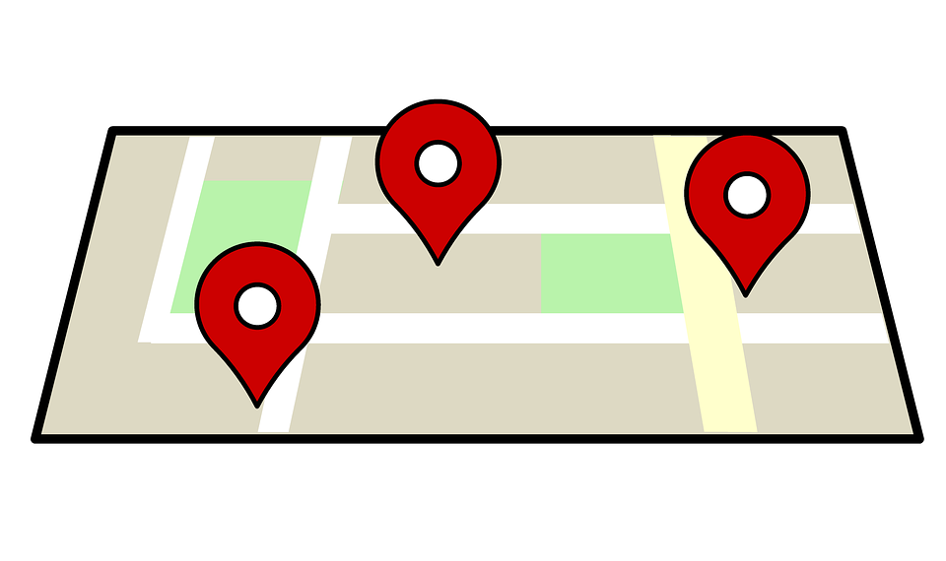
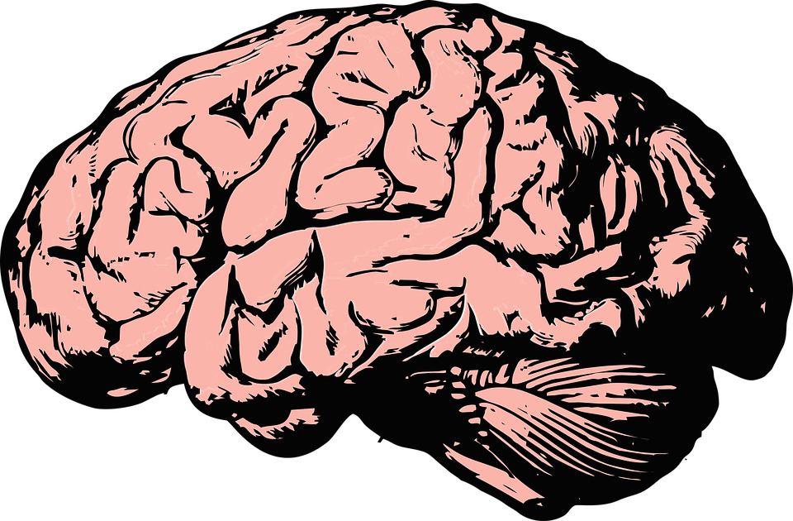


Why Convolutional Layer?
Fully connected or dense layer does not include relation among the surrounding pixels.
Well suited for classifying images.
The network resembles ‘visual cortex’ in brain.
vs.

Slide 3
Other resources

